Slide 1
Types of Business Intelligence Tools and Applications
Ad hoc analysis
Online Analytical processing
Mobile BI
Real time BI
Operation Intelligence
Open-Source BI
Embedded BI
Collaborative BI
Location Intelligence
Business intelligence vendors and market
Sehrish Aqeel
www.aisciences.io

Slide 2
Collaborative Business Intelligence
Collaborative BI (collaborative business intelligence) is the merging of business intelligence software with collaboration tools, including social and Web 2.0 technologies, to support improved data-driven decision making.
It can be applied to enterprise-wide reporting and analytics, making the sharing process easier and enabling more efficient decision making among team members who may have been working to reach conclusions on an individual basis.

Slide 3
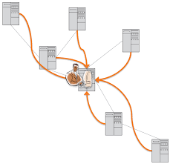

Collaborative Business Intelligence
Tools allow peers to analyze data and exchange information and ideas through Web 2.0 tools like blogs and wikis.
Modern tools also support brainstorming through social networking-like features, which continue to gain popularity for both business and personal use.

Slide 4
